Slide 1
LAB
NOTEBOOK
EECT 101-50C
MR. TOTH
SPRING 2015
BY:
ALCIDES SEGOVIA

Slide 2
Labs
Lab 1 – Test Equipment Intro and Resistors 3
Lab 2 – Resistors, DMM and Ohm’s Law 7
Lab 3 – Resistors, Multisim and Ohm’s Law 12
Lab 4 – Test Equipment Basics 15
Lab 5 – Test Equipment, Capacitors, and Inductors 22
Lab 6 – Learn to Solder 25
Lab 7 – CD-1 Checkout and 1st Solder Kit 28
Lab 8 – 555 Timer Chip 34
Lab 9 – Filters 38
Lab 10 – Square Wave to Sine Wave 42
Lab 11 – Troubleshoot Home Electronics 45
Lab 12 – Lissajous Pattern 52
Lab 13 – AC to DC Power Supplies 54
Lab 14 – ESD 57
Lab 15 – Test Old 0-30VC 61
Lab 16 – Soldering 63

Slide 3
Lab 1 - Test Equipment Intro and Resistors
Test Equipment
Objective
Learn the test equipment.
Digital Multimeter (DMM)
Function Generator
Oscilloscope (a.k.a. scope)
Power Supply (fixed and programmable)
LCR Meter
Research and Information on Test Equipment
Watched videos on test equipment and how to use them. https://online.ivytech.edu/bbcswebdav/pid-24889078-dt-content-rid-58475683_1/courses/EECT101-50C-C1-201430/EECT101-50C-C1-201430_ImportedContent_20150114121945/ee101_vids_inst.htm

Slide 4
Testing Resistors
Lab 1 - Test Equipment Intro and Resistors
Objective
Learn what a resistor is.
Learn the resistor color code.
Learn Ohm’s law.
Measure 3 resistors.
Equipment and Material
DMM
Resistors: 1kΩ, 300Ω, and 39kΩ
Research and Information
Watched videos on how to use DMM to measure resistors. (https://online.ivytech.edu/bbcswebdav/pid-24889078-dt-content-rid-58475683_1/xid-58475683_1)
Watched video on resistor color codes. (https://online.ivytech.edu/bbcswebdav/pid-24974867-dt-content-rid-58475684_1/xid-58475684_1)

Slide 5
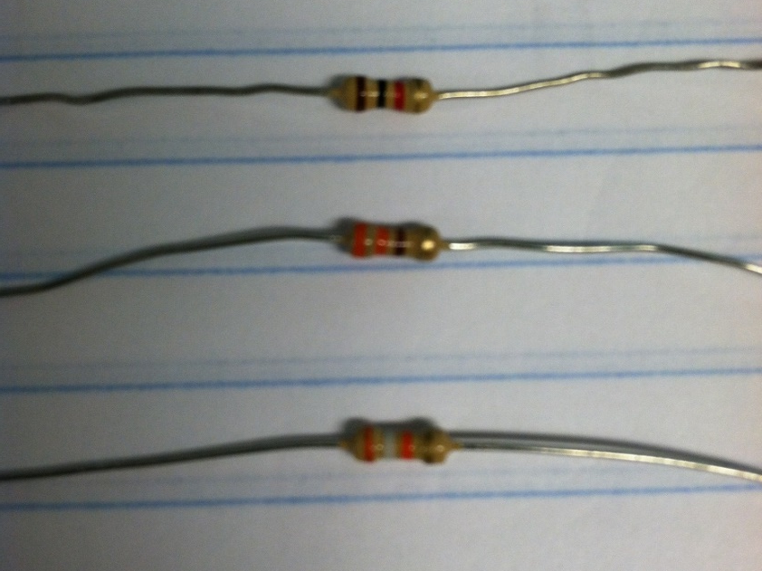
Measuring Resistors
Lab 1 - Test Equipment Intro and Resistors
 | 1st digit | 2nd digit | 3rd digit | Tolerance | Resistance according to color
1 | br | bl | r | gd | R |  | Range |  |  | DM Reading
 | 1 | 0 | 100 | 0.05 | 1000 | Ohms | 950 | to | 1050 | 999
2 | o | o | br | gd | R |  | Range |  |  | DM Reading
 | 3 | 3 | 10 | 0.05 | 330 | Ohms | 313.5 | to | 346.5 | 324.16
3 | o | w | o | gd | R |  | Range |  |  | DM Reading
 | 3 | 9 | 1000 | 0.05 | 39000 | Ohms | 37050 | to | 40950 | 38731

Slide 6
Lab 1 - Test Equipment Intro and Resistors
Summary and Conclusion
Summary
We were introduced to the test equipment.
We learned what a resistor is.
We learned about the resistor color code. (BBROYGBPGWGS)
We learned Ohm’s law.
We measure 3 resistors.
Conclusion
The resistors that were measured fell between the tolerance of each resistor.

Slide 7
Lab 2 - Resistors, DMM and Ohm’s Law
Objective
Learn how to use a Multimeter to measure resistance.
Measure 5 different resistors
Calculate expected value of 5 resistors in series and in parallel.
Put resistors in series and then in parallel.
Measure the currents.
Compare calculated with measured
Equipment and Material
Multimeter
Resistors: 330Ω, 820Ω, 2.2kΩ, 4.7 k Ω, and 1.0 kΩ
Research and Information
Review Ohm’s law power point

Slide 8
Lab 2 - Resistors, DMM and Ohm’s Law
Measurements
R (Series) | Calculated | Measured | Max | Min
R1 | 330.00 | 325.13 | 346.50 | 313.50 | Ohms
R2 | 820.00 | 818.1 | 861.00 | 779.00 | Ohms
R3 | 2.2E+3 | 2162.2 | 2.3E+3 | 2.09E+3 | Ohms
R4 | 4.7E+3 | 4598.8 | 4.9E+3 | 4.465E+3 | Ohms
R5 | 1.0E+3 | 978.4 | 1.1E+3 | 950.00 | Ohms
R1-3 | 3.35E+3 | 3.31E+3 | 3.52E+3 | 3.18E+3 | Ohms
R1-5 | 9.05E+3 | 8.88E+3 | 9.50E+3 | 8.60E+3 | Ohms
IT (1-3) | 1.5E-3 | 1.45E-3 | 1.5E-3 | 1.40E-3 | mA
IT (1-5) | 545.6E-6 | 499.13E-6 | 572.9E-6 | 518.4E-6 | µA
V | 4.938
R (Parallel) | Calculated | Measured | Max | Min
R1 | 330.00 | 325.13 | 346.50 | 313.50 | Ohms
R2 | 820.00 | 818.1 | 861.00 | 779.00 | Ohms
R3 | 2.2E+3 | 2162.2 | 2.3E+3 | 2.1E+3 | Ohms
R4 | 4.7E+3 | 4598.8 | 4.9E+3 | 4.5E+3 | Ohms
R5 | 1.0E+3 | 978.4 | 1.1E+3 | 950.00 | Ohms
R1-3 | 212.57 | 210.16 | 223.20 | 201.94 | Ohms
R1-4 | 203.37 | 200.93 | 213.54 | 193.20 | Ohms
IT (1-3) | 23.2E-3 | 22.31E-3 | 24.4E-3 | 22.1E-3 | mA
IT (1-4) | 24.3E-3 | 23.29E-3 | 25.5E-3 | 23.07E-3 | mA
V | 4.938

Slide 9
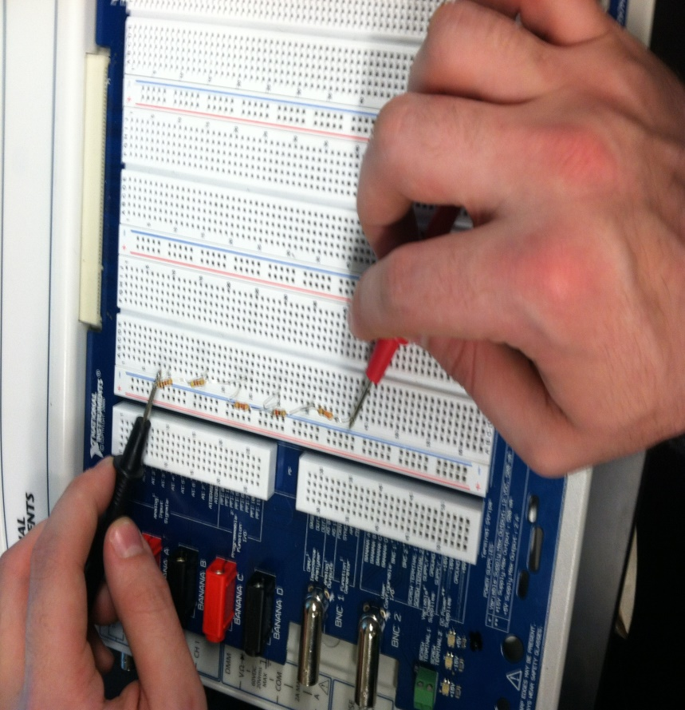
In Series

Slide 10
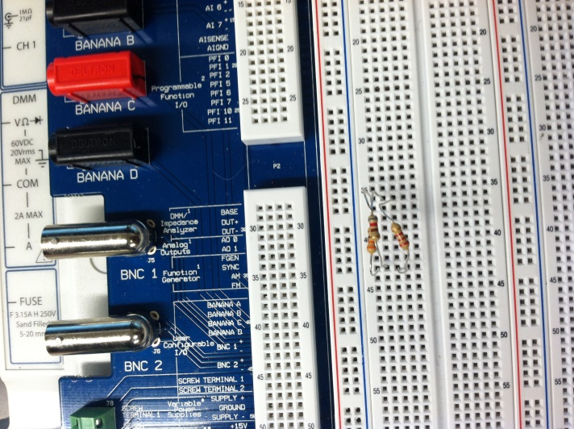
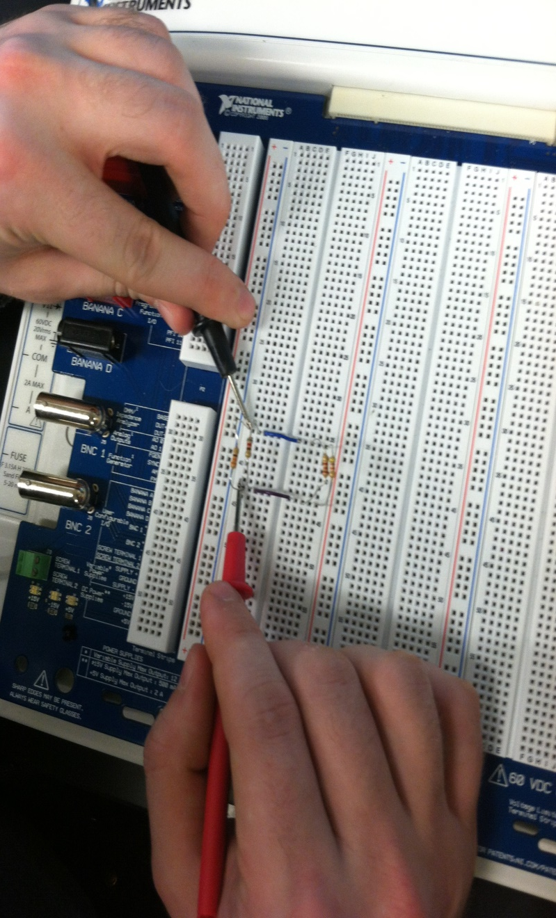
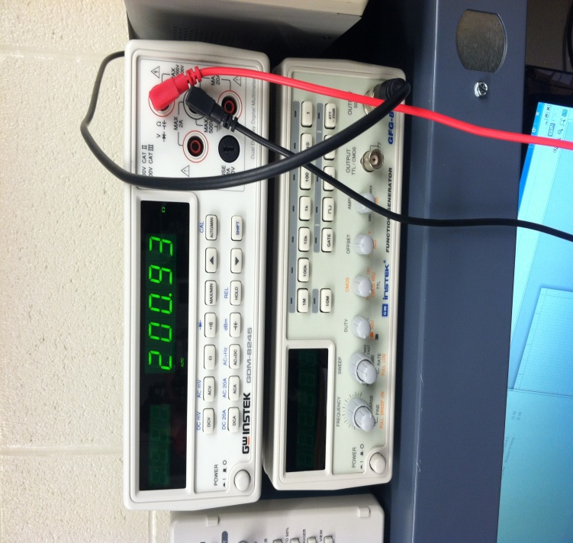
In Parallel

Slide 11
Lab 2 - Resistors, DMM and Ohm’s Law
Summary and Conclusion
Summary
We learned how to use a Multimeter to measure the resistance of a resistor.
We measured 5 different resistors individually.
We calculate the expected value of the 5 resistors in series, and then in parallel.
We put the 5 resistors in series and then in parallel.
We measure the currents in both.
Compared the calculated value with measured value.
Conclusion
Current can be calculated.
Measured values were with-in the tolorence.

Slide 12
Lab 3 - Resistors, Multisim and Ohm’s Law
Objective
Use Multisim to create 5 resistors in series and parallel.
Use Multimeter to measure resistance.
Compare calculated in multisim with measured
Equipment and Material
Multimeter
Multisim
Resistors: 330Ω, 820Ω, 2.2kΩ, 4.7 k Ω, and 1.0 kΩ
Research and Information
Review Ohm’s law power point
Watch Multisim videos in blackboard

Slide 13
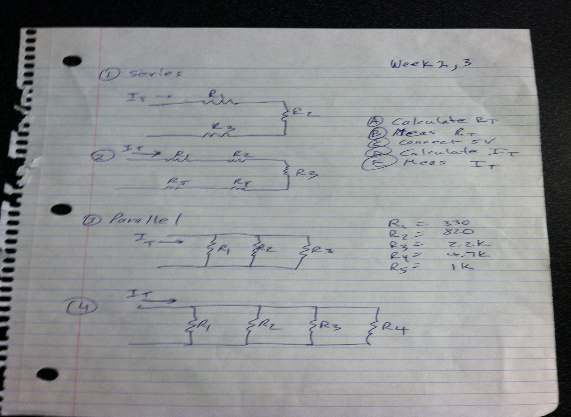
Lab 3 - Resistors, Multisim and Ohm’s Law
Different Resistor Set-ups

Slide 14
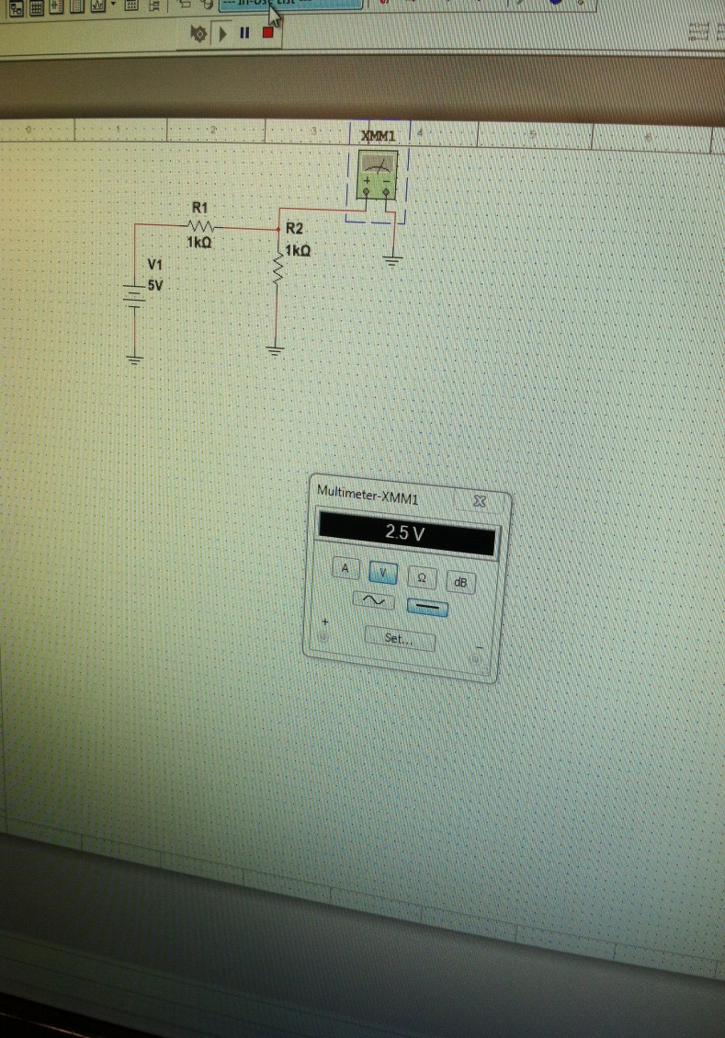
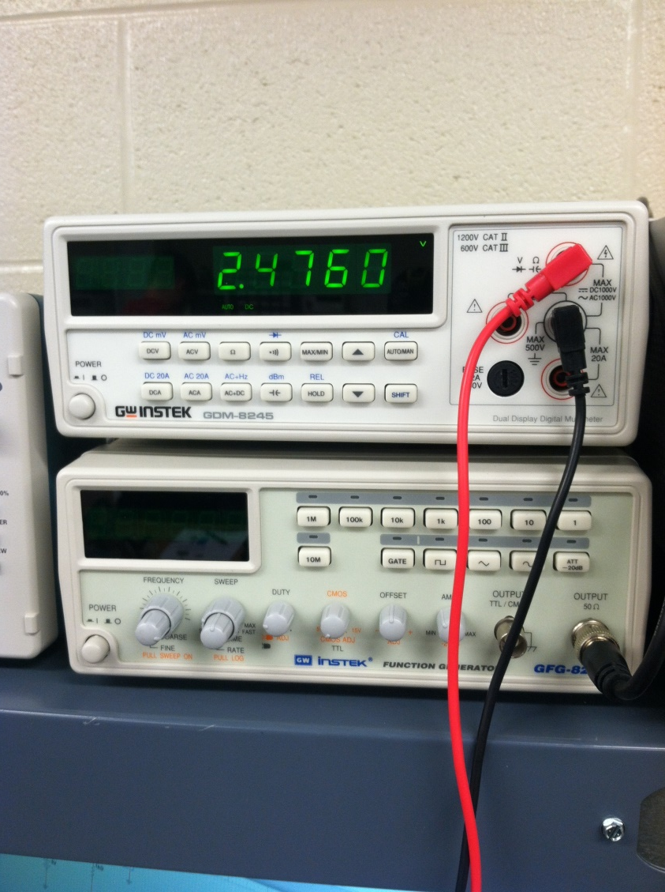
Multisim vs Measured
Lab 3 - Resistors, Multisim and Ohm’s Law

Slide 15
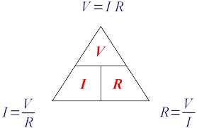
Lab 3 - Resistors, Multisim and Ohm’s Law
Summary and Conclusion
Summary
Learned Ohm’s Law
Resistors were tested to see if the were within tolerance.
Conclusion
Current can be calculated.
Measured values were with-in the tolorence.

Slide 16
Lab 4 Test Equipment Basics
Objective
Use the Function Generator to provide different measurements.
Use Oscilloscope to verify the output.
Equipment and Material
Function Generator
Oscilloscope
DMM
Research and Information
Watched videos on how to use the Function Generator and Ocilloscope in https://online.ivytech.edu/bbcswebdav/pid-24889087-dt-content-rid-58475674_1/courses/EECT101-50C-C1-201430/EECT101-50C-C1-201430_ImportedContent_20150114121945/ee101_vids_oscilloscope.htm

Slide 17
Lab 4 Test Equipment Basics
1st Set-up
1.a. | Set up the Function Generator to provide a 100Hz sine wave at 1V P-P.
 | Record the settings of the Function Generator.
 | Frequency button = 100, Sine wave pushed
 | Nobs pushed in: DUTY, CMOS, OFFSET
 | Pulled out: Ampl to about the 11'o clock mark
1.b. | Use an Oscilloscope to verify the output of the function generator. Record the settings of the
 | Oscilloscope. |  | (Horiz scale X # of divisions = period. Vert scale X # of div = amplitude)
 | Period (Horizontal): 4 divisions x 2.5 ms = 10ms
 | Amplitude (Vertical): 1 division x 1 volt = 1V
1.c. | Measure the following: |  |  |  |  |  |  | Units:
 | a. | Period of the sine wave |  |  |  | 10 |  | ms
 | b. | Amplitude of the sine wave |  |  |  | 1 |  | Vrms
 | c. | Rise time of the sine wave |  |  |  | 5 |  | ms
 | d. | Fall time of the sine wave |  |  |  | 5 |  | ms

Slide 18
Lab 4 Test Equipment Basics
2nd Set-up
2.a. | Set up the Function Generator to provide a 1KHz square wave at 5V P-P, 50% duty cycle.
 | Record the settings of the Function Generator.
 | Frequency button = 1k, square wave pushed
 | Nobs pushed in: DUTY, CMOS, OFFSET
 | Pulled out: Ampl to about the 9'o clock mark
2.b. | Use an Oscilloscope to verify the output of the function generator. Record the settings of the
 | Oscilloscope. |  | (Horiz scale X # of divisions = period. Vert scale X # of div = amplitude)
 | Period (Horizontal): 4 divisions x 250 µs = 1ms
 | Amplitude (Vertical): 1 division x 5 v = 5V
 | Pulse (Horizontal): period x 50% duty cycle
2.c. | Measure the following: |  |  |  |  |  |  | Units:
 | a. | Period of the square wave |  |  |  | 1 |  | ms
 | b. | Pulse width of the square wave |  |  |  | 500 |  | µs
 | c. | Amplitude of the square wave |  |  |  | 5 |  | V
 | d. | Rise time of the square wave |  |  |  | 250 |  | ns
 | e. | Fall time of the square wave |  |  |  | 250 |  | ns

Slide 19
Lab 4 Test Equipment Basics
3rd Set-up
3.a. | Change the square wave to an 80/20 duty cycle. Record the settings of the Function Generator.
 | Frequency button = 1k, square wave pushed
 | Nobs pushed in: CMOS, OFFSET
 | Pulled out: Ampl to about the 9'o clock mark, DUTY to about the 4'o clock
3.b. | Use an Oscilloscope to verify the output of the function generator. Record the settings of the
 | Oscilloscope. |  | (Horiz scale X # of divisions = period. Vert scale X # of div = amplitude)
 | Period (Horizontal): 4 divisions x 250 µs = 1ms
 | Amplitude (Vertical): 2.5 division x 2 v = 5V
 | Pulse (Horizontal): period x 80/20 duty cycle
3.c. | Measure the following: |  |  |  |  |  |  | Units:
 | a. | Period of the square wave |  |  |  | 1 |  | ms
 | b. | Pulse width of the square wave |  |  |  | 0.8 |  | ms
 | c. | Amplitude of the square wave |  |  |  | 5 |  | V
 | d. | Rise time of the square wave |  |  |  | 250 |  | ns
 | e. | Fall time of the square wave |  |  |  | 250 |  | ns

Slide 20
Lab 4 Test Equipment Basics
4th Set-up
4.a. | Change the square wave to a one-shot that is high for 10ms and off for the rest of the 1000ms period.
 | Record the settings of the Func Generator.
 | Frequency button = 100 Hz, Reading 9.95 Hz, square wave pushed
 | Nobs pushed in: CMOS, OFFSET
 | Pulled out: Ampl to about the 9'o clock mark, DUTY to about the 7'o clock
4.b. | Use an Oscilloscope to verify the output of the function generator. Record the settings of the
 | Oscilloscope.
 | Period (Horizontal): 1.4 divisions x 10.0 ms = 14ms ( Reached limitation on Function generator)
 | Amplitude (Vertical): 4.8 division x 1 v = 4.8V
 | Pulse (Horizontal): period x 80/20 duty cycle
4.c. | Measure the following: |  |  |  |  |  |  | Units:
 | a. | Period of the square wave |  |  |  | 14 |  | ms
 | b. | Pulse width of the square wave |  |  |  | 0.1 |  | ms
 | c. | Amplitude of the square wave |  |  |  | 4.8 |  | v
 | d. | Rise time of the square wave |  |  |  | 0.25 |  | ms
 | e. | Fall time of the square wave |  |  |  | 0.25 |  | ms

Slide 21
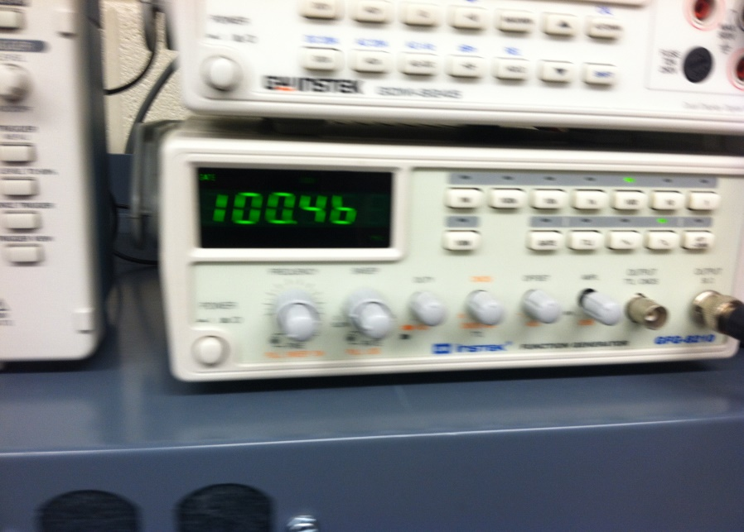
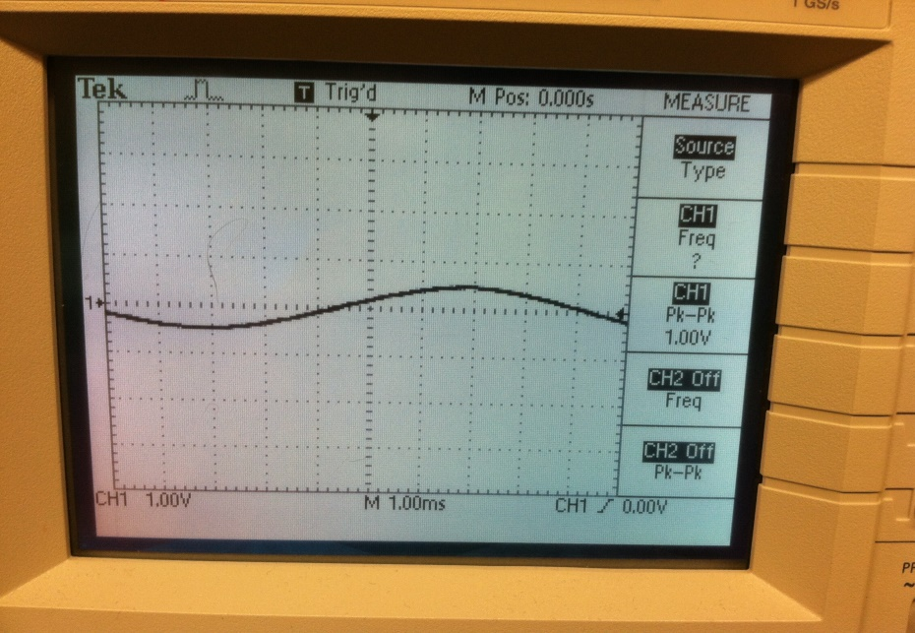
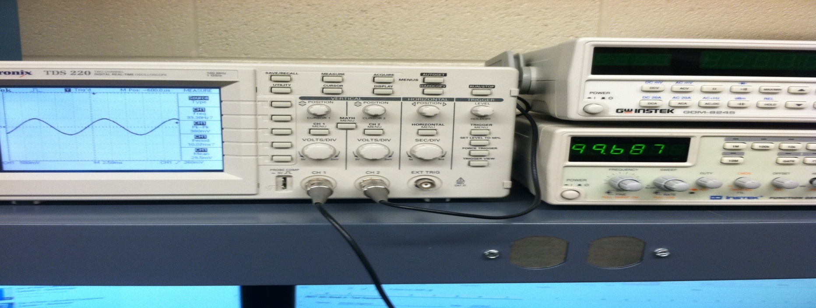
Lab 4

Slide 22
Lab 4 Test Equipment Basics
Summary and Conclusion
Summary
Use the Function Generator to provide 4 different waves to measurements.
Use Oscilloscope to verify the wave output.
Conclusion
We were able to measure the waves
Period
Amplitude
Rise/Fall

Slide 23
Lab 5 - Test Equipment, Capacitors, and Inductors
Objective
Use the LCR meter to measure inductors and capacitors. Including hand-wound inductors
Measure: 4 Capacitors and 3 Standard Inductors
Measure 3 hand-wound Inductors
Equipment and Material
Capacitors: 4.7 pF, .0033 µF, .01 µF, and 4.7 µF
LCR Meter, Oscilloscope, Function Generator
Research and Information
Watched videos on Inductors: https://online.ivytech.edu/bbcswebdav/pid-24889093-dt-content-rid-58475677_1/courses/EECT101-50C-C1-201430/EECT101-50C-C1-201430_ImportedContent_20150114121945/ee101_vids_inductors.htm
Watched videos on Capacitors: https://online.ivytech.edu/bbcswebdav/pid-24889094-dt-content-rid-58475678_1/courses/EECT101-50C-C1-201430/EECT101-50C-C1-201430_ImportedContent_20150114121945/ee101_vids_capacitors.htm

Slide 24
Lab 5 - Test Equipment, Capacitors, and Inductors
Capacitors
Measure the following: |  |  |  |  | Expected: |  | Measured:
a. | 4 capacitors, incl 1 that is electrolytic |  |  |  | 4.7 | pF | 4.95 | pF
 |  |  |  |  | 0.0033 | µF | 0.00329 | µF
 |  |  |  |  | 0.01 | µF | 0.0096 | µF
 |  |  |  |  | 4.7 | µF | 3.329 | µF

Slide 25
Lab 5 - Test Equipment, Capacitors, and Inductors
Hand-wound Inductors
Looked up the inductance value for the rings
Measure the following: |  |  |  |  | Expected: |  | Measured:
a. | 3 inductors |  |  |  | 100 | µH | 107.76 | µH
 |  |  |  |  | 22 | mH | 20.64 | mH
 |  |  |  |  | 100 | mH | 97.3 | mH

Slide 26
Lab 6 – Learn to Solder
Objective
Learn how to Solder and unsolder
Equipment and Material
Soldering Iron.
Wet Sponge
Angle Cutter
Pliers
Wires
Small proto board
Research and Information
Watched videos on how to solder:
Soldering Techniques: Part 6, from Ivy Tech Engineering
How to solder & unsolder review from YouTube
Beginner, How to solder from YouTube
Soldering Techniques from YouTube

Slide 27
Lab 6 – Learn to Solder
Solder on to a proto board:
4 Resistors of 2 different sizes
1 Electrolytic Capacitor
1 Signal diode
3 Rectifier Diodes of 2 different sizes
1 Inductor
1 Transistor

Slide 28
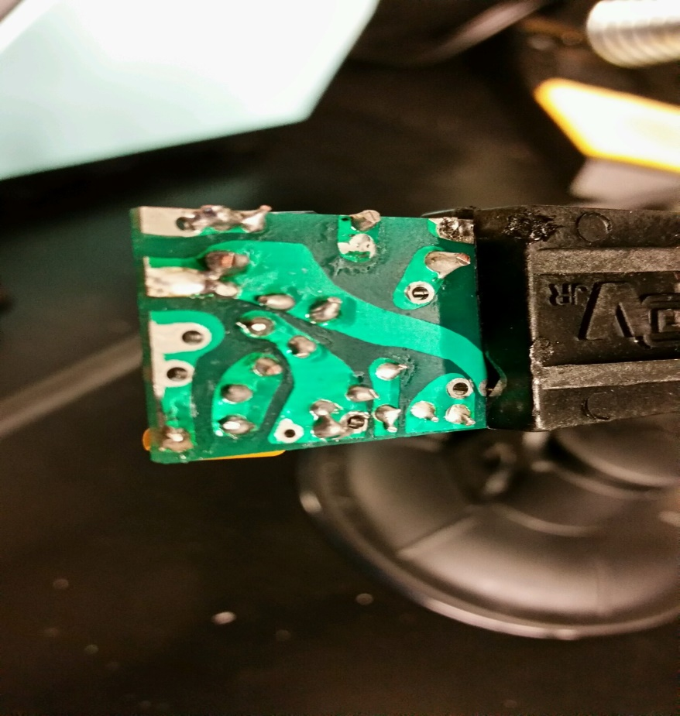
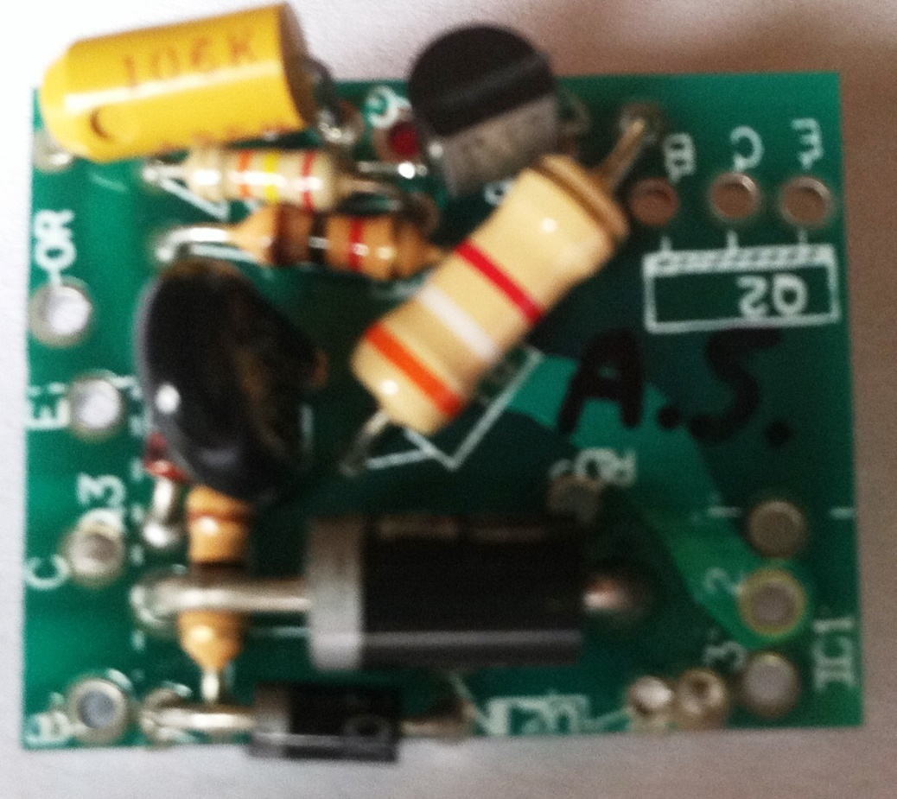
Lab 6 – Learn to Solder

Slide 29
Lab 7-A – CD-1 Checkout
Objective
Identify all the different components in an old CMOS/TTL CD-1 board from the 80’s
Identify the two families of ICs
Equipment and Material
Eli – CMOS/TTL Designer, CD-1, Series# 40512
Research and Information
Review components from previous labs.

Slide 30
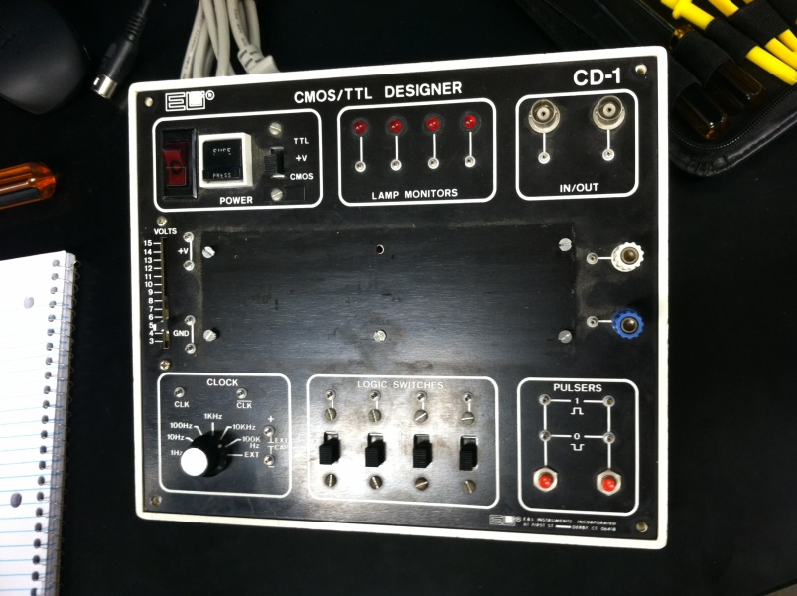
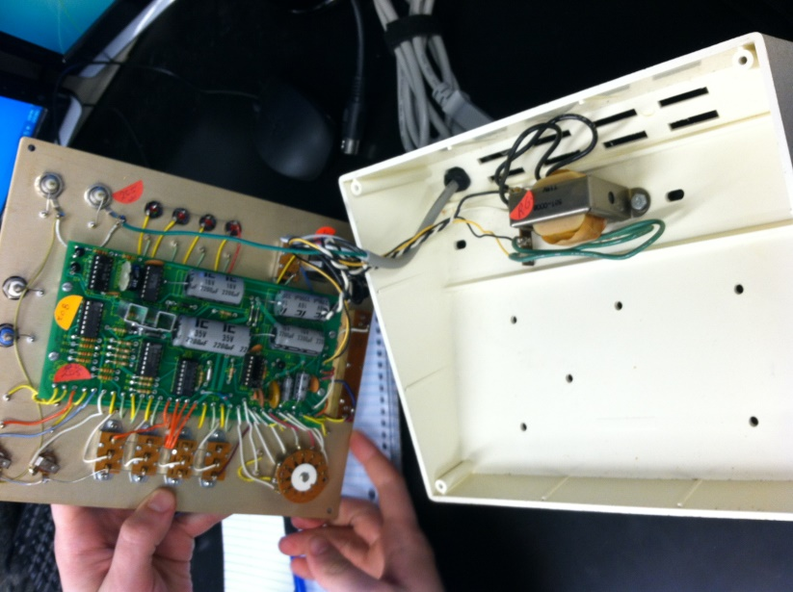
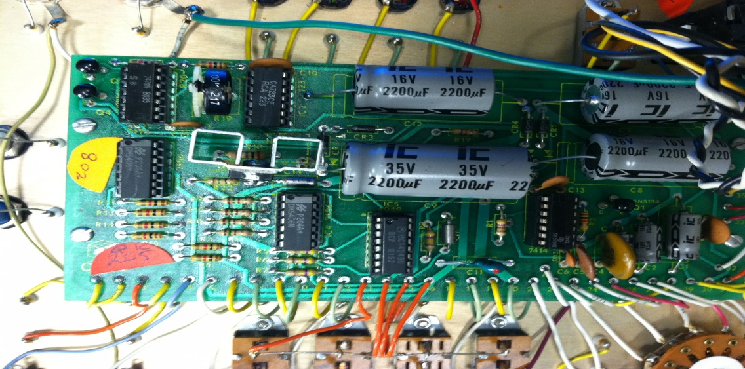
Lab 7-A – CD-1 Checkout

Slide 31
Lab 7-A – CD-1 Checkout
Resistors:
9 - 1000Ω
4 - 150 Ω
1 - 75 Ω
1 - 2 Ω
1 – 4.7k Ω
4 – 470k Ω
1 - 47 Ω
Potentiometer
100k
Capacitor
Diodes (+)
Rectifier

Slide 32
Lab 7-B – First Solder Kit
Objective
Solder together a Flashing LED Vellman Kit
Equipment and Material
Soldering Iron.
Wet Sponge
Angle Cutter
Vellman Kit (MK102) with schematic
Resistors: 2 @ 1kΩ, 2 @ 10KΩ
Trimmers: 2 @ 250K
Transistors: 2 – BC547
Electrolytic Capacitors: 2 @ 10µF
LEDs: 2 – 5mm
Research and Information
Review components from previous labs.

Slide 33
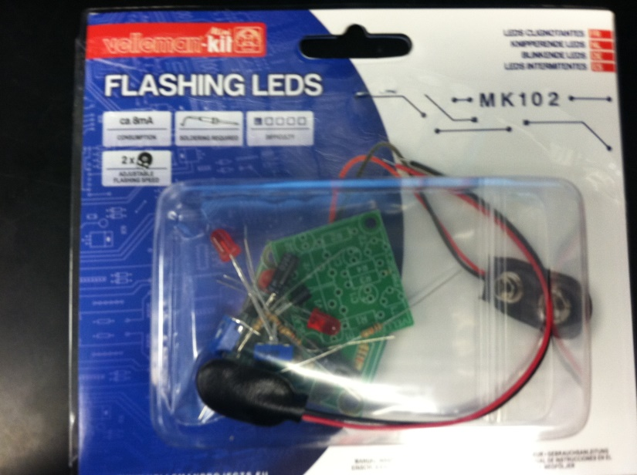
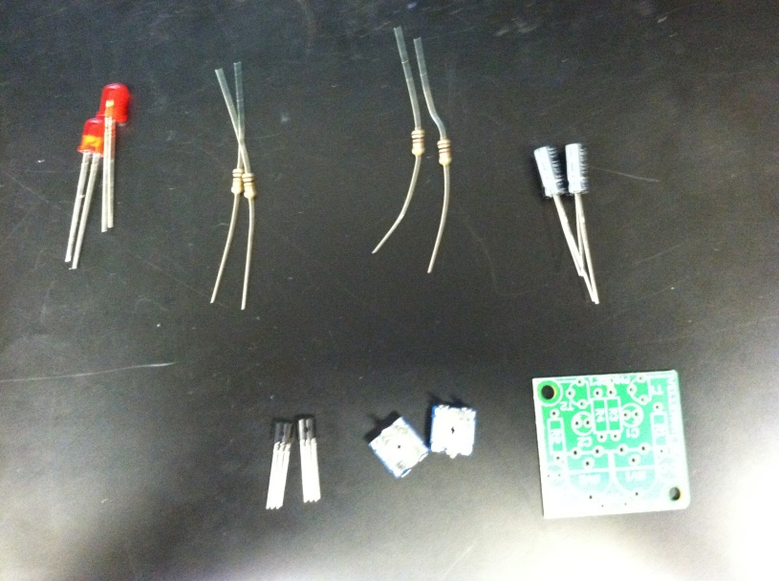
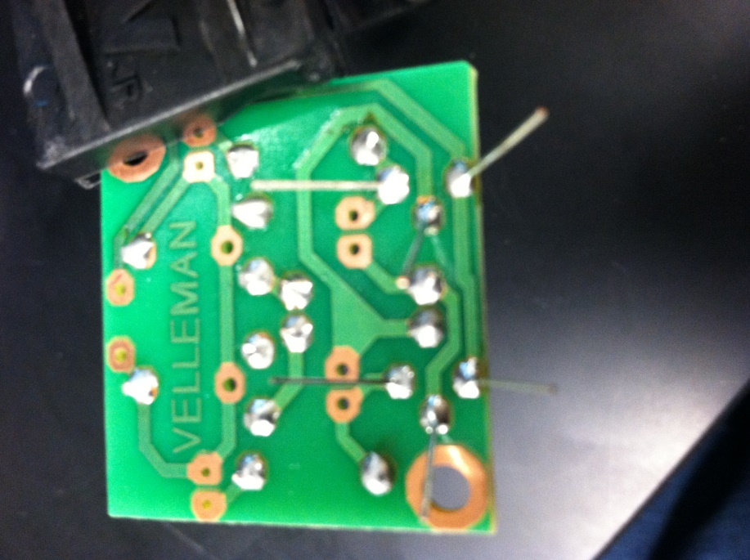
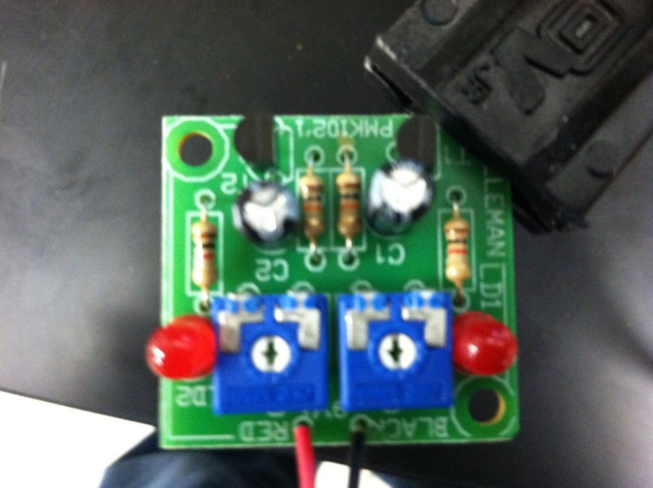
Lab 7-B – First Solder Kit

Slide 34
Lab 7-B – First Solder Kit

Slide 35
Lab 8 – 555 Timer Chip
Objective
Find formula to set frequency and calculate values needed for frequencies: 0.5Hz, 1Hz, and 2Hz
Verify frequencies with an oscilloscope
Learn about common cathode and common anode LEDs and why current limiting resistors are needed
Equipment and Material
Research and Information
555 Timer Chip and formula at http://www.doctronics.co.uk/555.htm
DMM
Oscilloscope
Power Supply
LCR Meter
555 Timer Chip
Solderless breadboard
Resistors
Capacitors
LED
Jumper wires

Slide 36
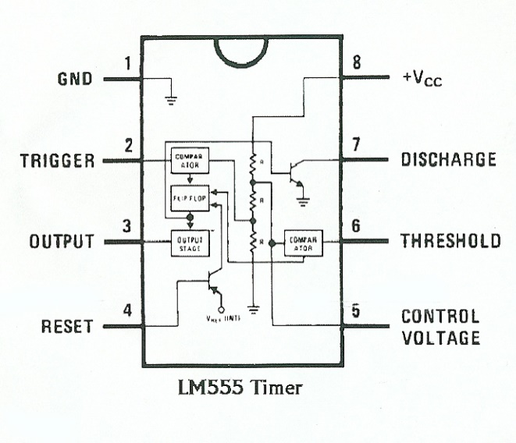
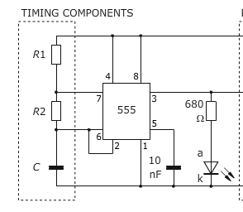
Lab 8 – 555 Timer Chip

Slide 37
Lab 8 – 555 Timer Chip
Calculated Rb for each frequency
F = 1.44/((RA + 2RB)*C) |  |  | Duty Cycle = 1 - (RB/(RA + 2RB))
F | 0.5 |  | 50.97%
C | 1.00E-05
RA | 5.60E+03
RB | 1.41E+05
F = 1.44/((RA + 2RB)*C) |  |  | Duty Cycle = 1 - (RB/(RA + 2RB))
F | 1 |  | 51.94%
C | 1.00E-05
RA | 5.60E+03
RB | 6.92E+04
F = 1.44/((RA + 2RB)*C) |  |  | Duty Cycle = 1 - (RB/(RA + 2RB))
F | 2 |  | 53.89%
C | 1.00E-05
RA | 5.60E+03
RB | 3.32E+04
Measured Rb
Ra = | 5.6 KΩ | Rb = | 139 kΩ | C = | 10 µF | F = | 0.49 Hz
Ra = | 5.6 KΩ | Rb = | 69 kΩ | C = | 10 µF | F = | 1 Hz
Ra = | 5.6 KΩ | Rb = | 33 kΩ | C = | 10 µF | F = | 2 Hz

Slide 38
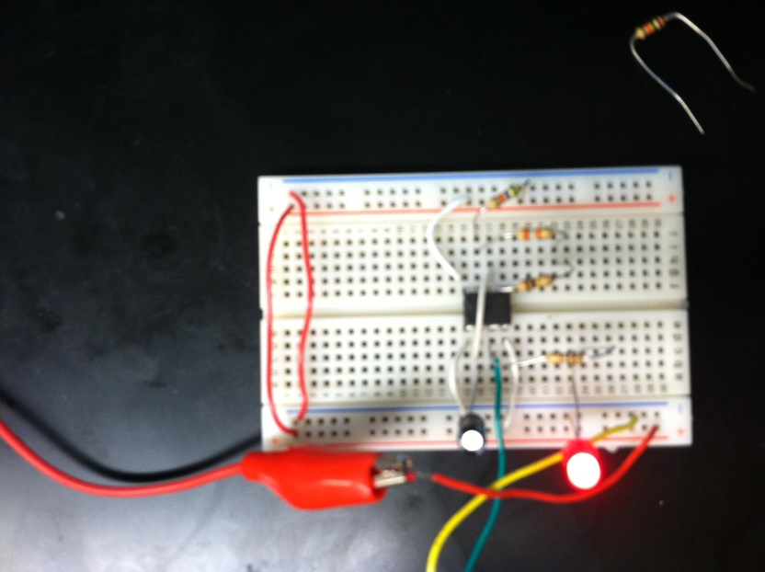
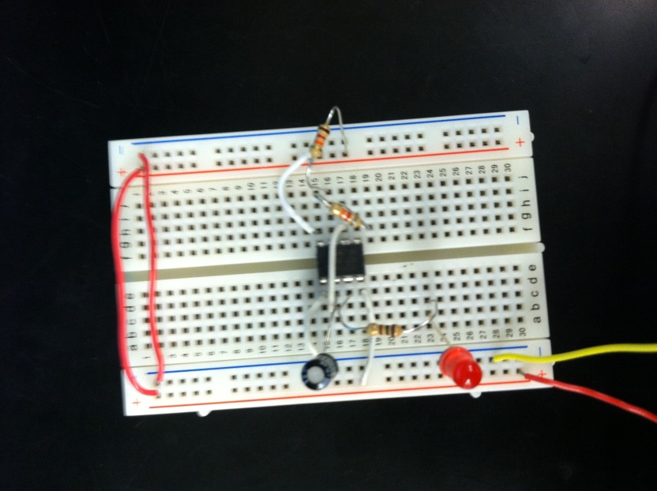
Lab 8 – 555 Timer Chip

Slide 39
Lab 9 – Filters
Objective
Build an RC lowpass Filter
Measure the frequency response from 10Hz to 100,000Hz.
Find cutoff frequency fc
Equipment and Material
LCR Meter
Oscilloscope
Function Generator
Research and Information
Low Pass Filter are made:
Low frequency (up to 100kHz) = RC (Resistor-Capacitor) network
High frequency (above 100kHz) = RLC (Resistor-Inductor-Capacitor) network
Formulas

Slide 40
Lab 9 – Filters
Formulas Used

Slide 41
Lab 9 – Filters
Resistor | Units | Capacitor | Units | Frequency | Vin | Units | Vout | Units | Capacitive reactance Xc= 1/(2πfC) | Units
985 | Ω | 0.478 | µF | 10 | 1 | V | 820 | mV | 7.50841E-06 | Ω
 |  |  |  | 20 | 1 | V | 940 | mV | 1.50168E-05
 |  |  |  | 30 | 1 | V | 970 | mV | 2.25252E-05
 |  |  |  | 40 | 1 | V | 980 | mV | 3.00336E-05
 |  |  |  | 50 | 1 | V | 980 | mV | 3.7542E-05
 |  |  |  | 60 | 1 | V | 980 | mV | 4.50504E-05
 |  |  |  | 70 | 1 | V | 980 | mV | 5.25588E-05
 |  |  |  | 80 | 1 | V | 980 | mV | 6.00673E-05
 |  |  |  | 90 | 1 | V | 960 | mV | 6.75757E-05
 |  |  |  | 100 | 1 | V | 950 | mV | 7.50841E-05
 |  |  |  | 200 | 1 | V | 880 | mV | 0.000150168
 |  |  |  | 300 | 1 | V | 760 | mV | 0.000225252
 |  |  |  | 400 | 1 | V | 660 | mV | 0.000300336
 |  |  |  | 500 | 1 | V | 580 | mV | 0.00037542
 |  |  |  | 600 | 1 | V | 520 | mV | 0.000450504
 |  |  |  | 700 | 1 | V | 450 | mV | 0.000525588
 |  |  |  | 800 | 1 | V | 410 | mV | 0.000600673
 |  |  |  | 900 | 1 | V | 380 | mV | 0.000675757
 |  |  |  | 1,000 | 1 | V | 312 | mV | 0.000750841
 |  |  |  | 2,000 | 1 | V | 164 | mV | 0.001501681
 |  |  |  | 3,000 | 1 | V | 112 | mV | 0.002252522
 |  |  |  | 4,000 | 1 | V | 86 | mV | 0.003003363
 |  |  |  | 5,000 | 1 | V | 66.4 | mV | 0.003754203
 |  |  |  | 6,000 | 1 | V | 56 | mV | 0.004505044
 |  |  |  | 7,000 | 1 | V | 48 | mV | 0.005255885
 |  |  |  | 8,000 | 1 | V | 40.4 | mV | 0.006006725
 |  |  |  | 9,000 | 1 | V | 36 | mV | 0.006757566
 |  |  |  | 10,000 | 1 | V | 32 | mV | 0.007508406
 |  |  |  | 20,000 | 1 | V | 16.8 | mV | 0.015016813
 |  |  |  | 30,000 | 1 | V | 11.8 | mV | 0.022525219
 |  |  |  | 40,000 | 1 | V | 9.7 | mV | 0.030033626
 |  |  |  | 50,000 | 1 | V | 7.8 | mV | 0.037542032
 |  |  |  | 60,000 | 1 | V | 7 | mV | 0.045050439
 |  |  |  | 70,000 | 1 | V | 6 | mV | 0.052558845
 |  |  |  | 80,000 | 1 | V | 5.5 | mV | 0.060067252
 |  |  |  | 90,000 | 1 | V | 5 | mV | 0.067575658
 |  |  |  | 100,000 | 1 | V | 4.8 | mV | 0.075084064
Cut-off Frequency Fc = 1/(2πRC)
338.0305909 | Hz

Slide 42
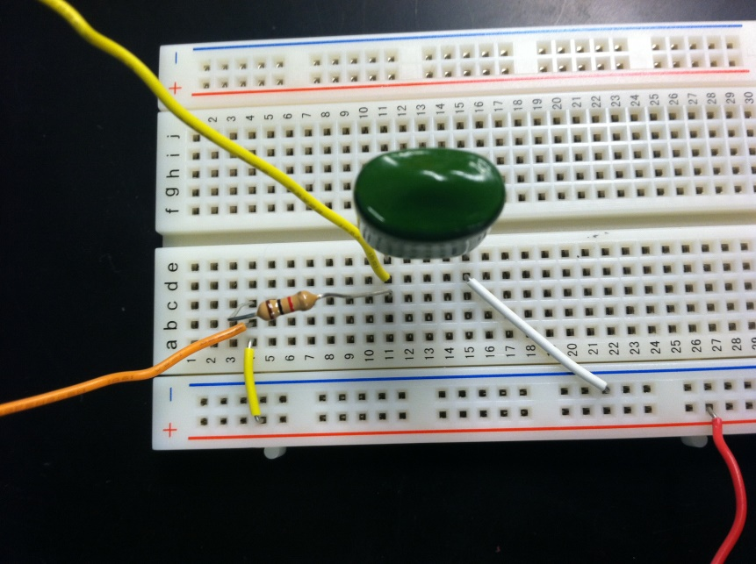
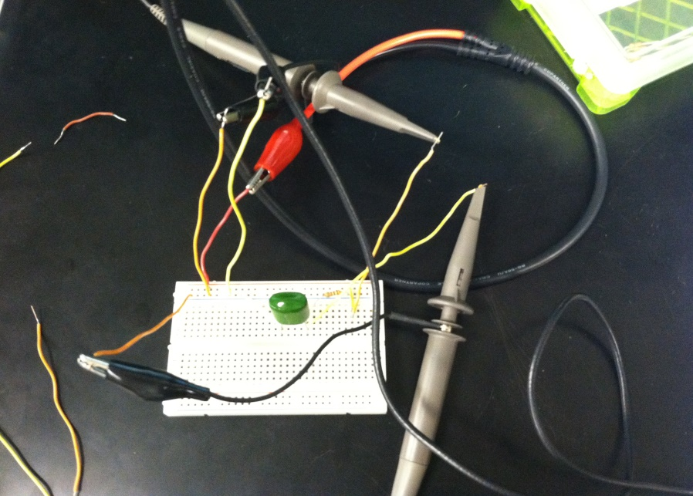
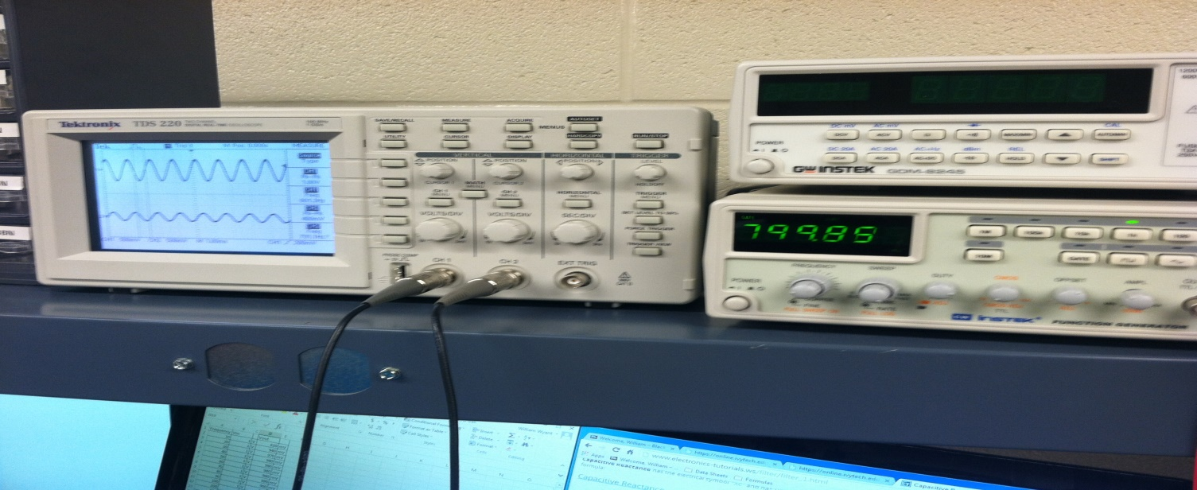
Lab 9 – Filters

Slide 43
Lab 10 – Square Wave to
Sine Wave
Objective
Convert a square wave into a sine wave
Equipment and Material
Multisim
Function Generator
Oscilloscope
4 - 22µF Capacitors
4 - 100Ω Resistors
Research and Information
Watched Youtube Video: “Change a square wave into a sine wave (3 pole RC Filter)”

Slide 44
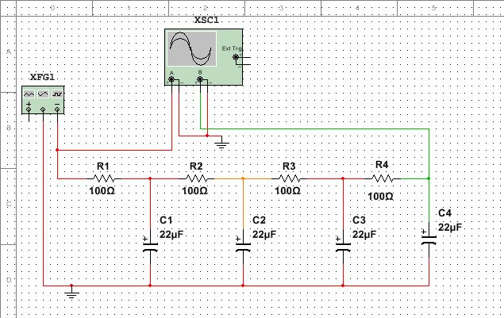
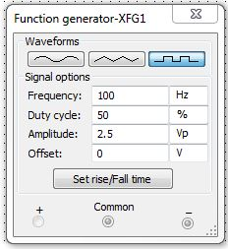
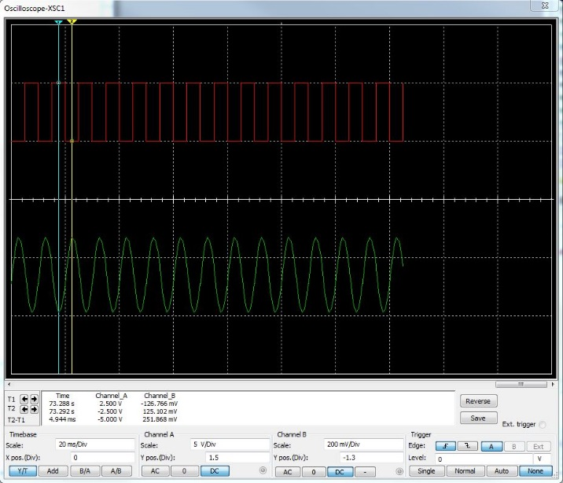
Lab 10 – Square Wave to
Sine Wave
Multisim

Slide 45
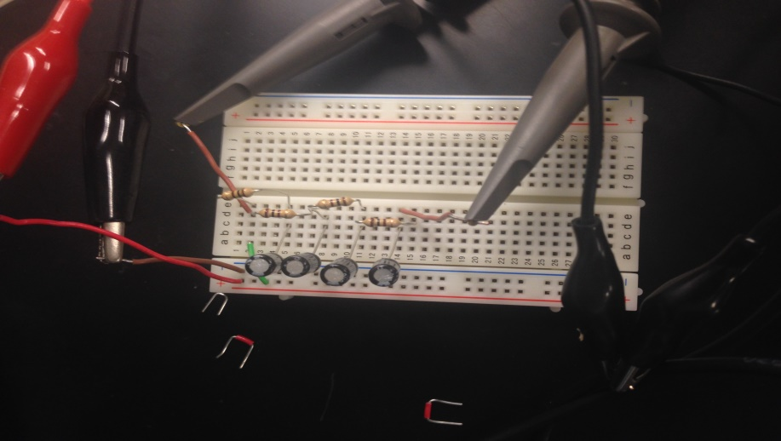
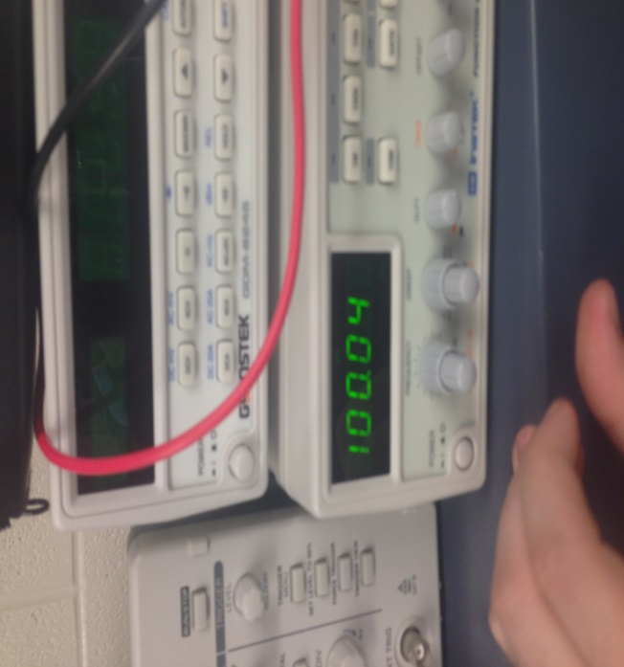
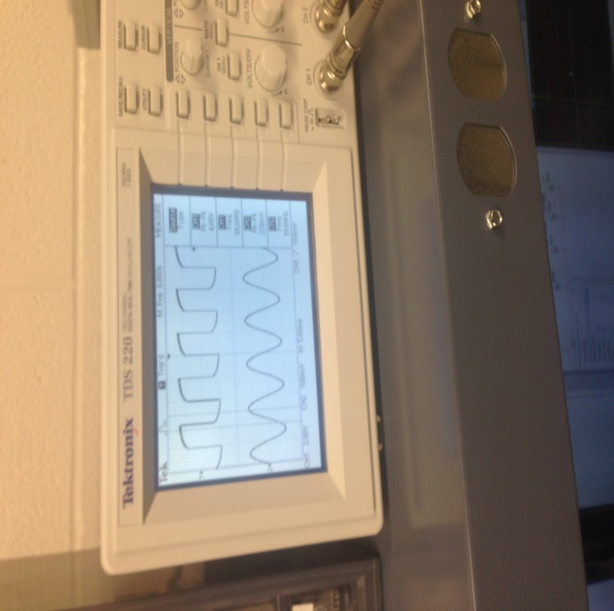
Lab 10 – Square Wave to
Sine Wave

Slide 46
Lab 11A – Troubleshoot/Fix
Home Electronic
Objective
Troubleshoot/fix a desktop
Equipment and Material
Desktop Computer:
HP Pavilion: a6403w
Research and Information
Upgrades for desktop computer

Slide 47
Lab 11A – Troubleshoot/Fix
Home Electronic
Original Problem from Home
Network Connection not working:
Tested network integrated port by connecting an Ethernet cable and found that it was not working.
Took out Modem and replaced it with an Ethernet card.
USB port not working:
Connected a standard USB mouse to all the port (4 in the back and 2 in the front) all worked.

Slide 48
Lab 11A – Troubleshoot/Fix
Home Electronic
Other thing found
Tested the optical drive by putting in a CD, it was working.
Noticed a lot of dust inside. Recommend to clean out.
CMOS battery is dead, needs replaced. (CR2032, 3V, lithium battery)
RAM is 2 – 1G, recommend upgrade to 2 – 2G.
No rear case fan, recommend installing a 80mm fan.
Defragged through Command Propt
Recommend upgrading CPU to an Intel Pentium Processor E2220

Slide 49
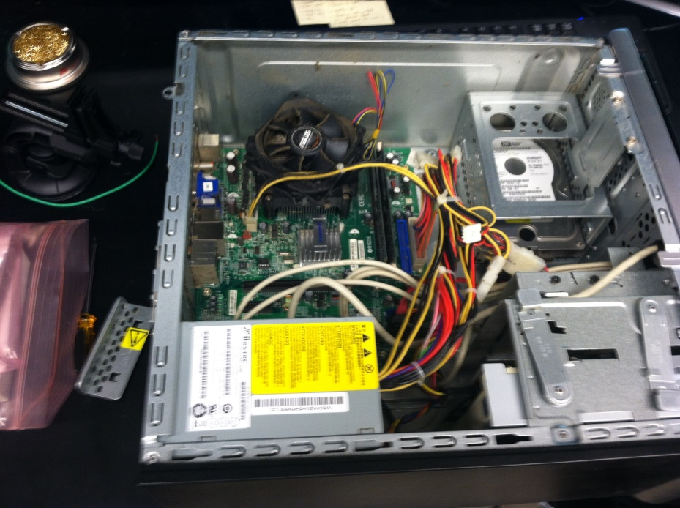
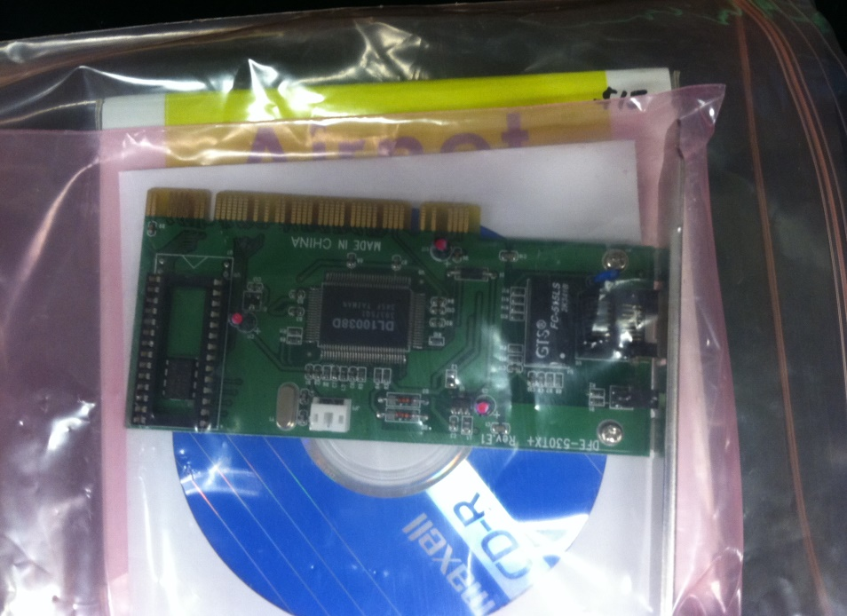
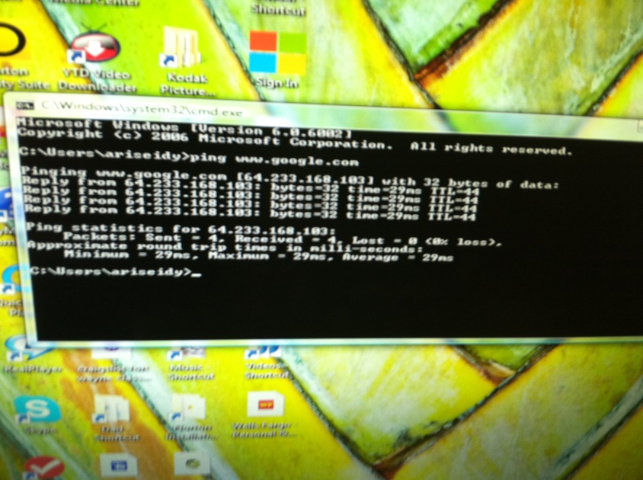
Lab 11A – Troubleshoot/Fix
Home Electronic

Slide 50
Lab 11B – Test
7400Series Chips
Objective
Build a tester with LED to test 7400 Series Chips
Equipment and Material
DC Power Supply
DMM
Solderless Breadboard
SN7432 Chips
1k Resistor
4 LEDs
Research and Information
Schematic for 7400 Series Chips

Slide 51
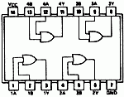
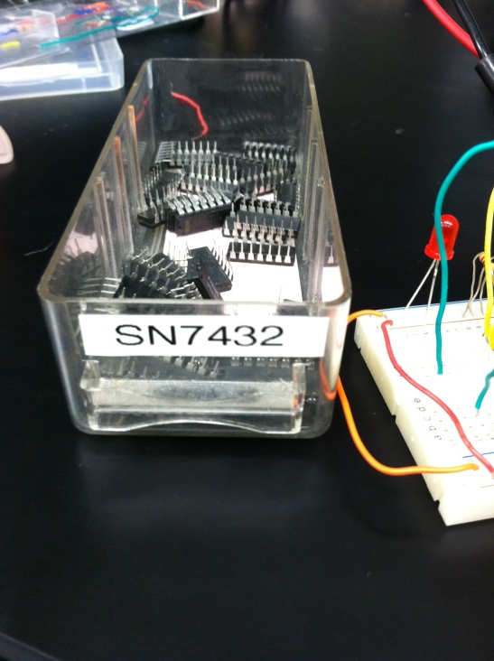
Lab 11B – Test
7400Series Chips
SN7432 – 2 input OR gate

Slide 52
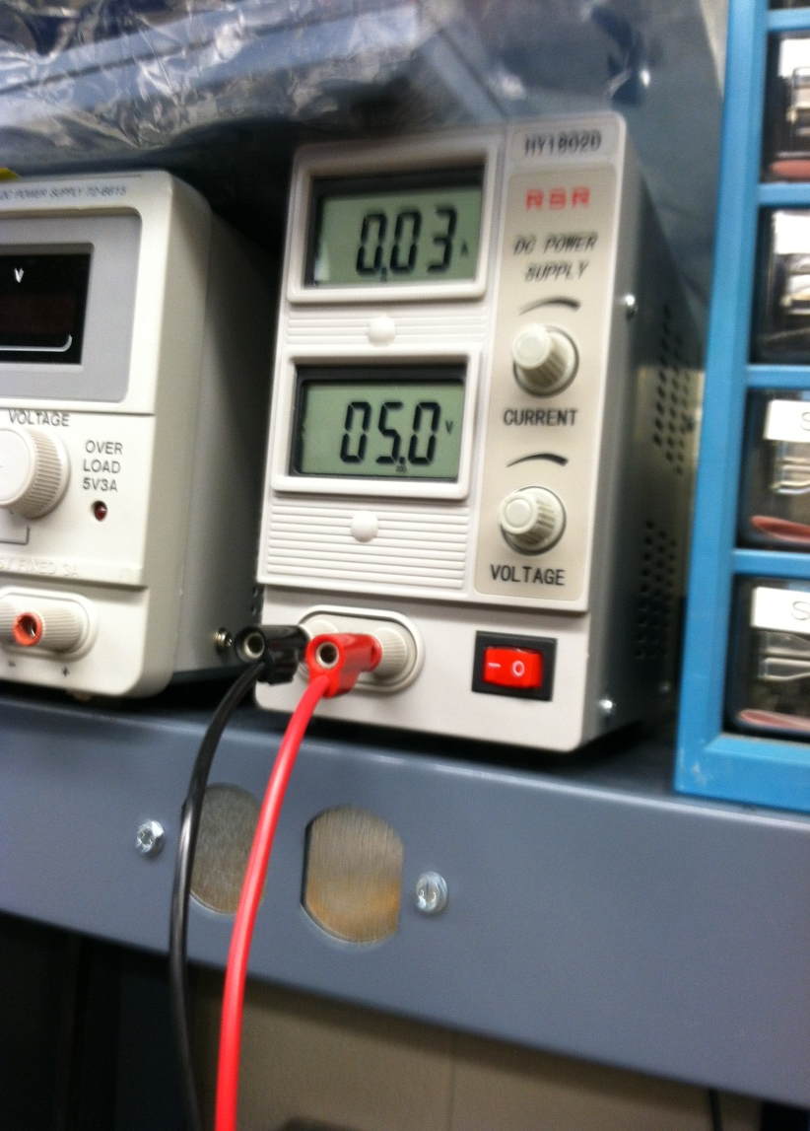
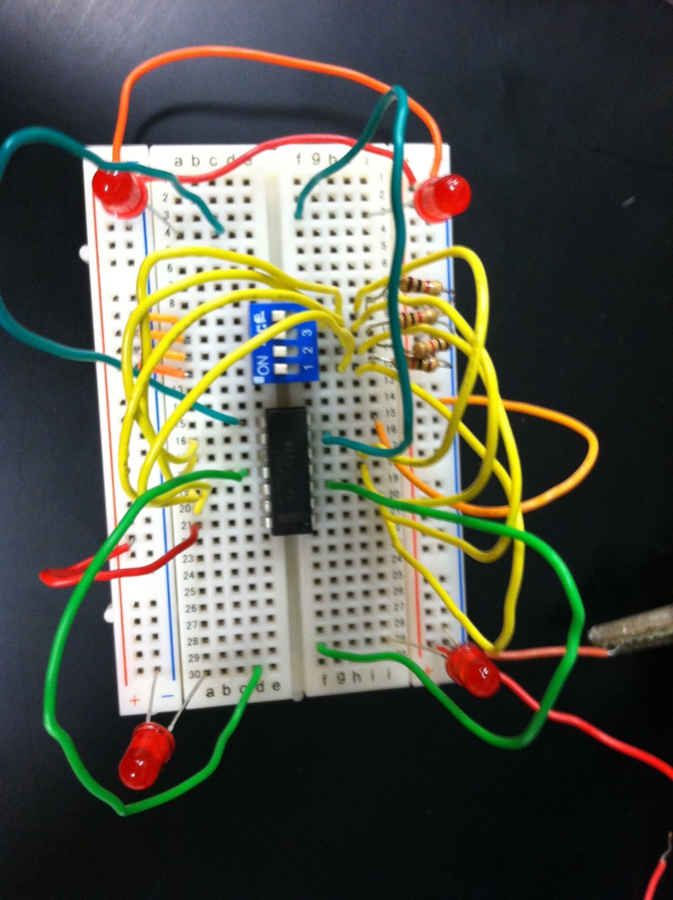
Lab 11B – Test
7400Series Chips

Slide 53
Lab 12 – Lissajous Pattern
Objective
Display a circle or an ellipse on an oscilloscope
Equipment and Material
Oscilloscope (x/y Mode)
Ch. 1 – Horizontal
Ch. 2 – Vertical
2 Function Generators
Research and Information
Watched: #48: Basics of lissajous Patterns on an Oscilloscope.”

Slide 54
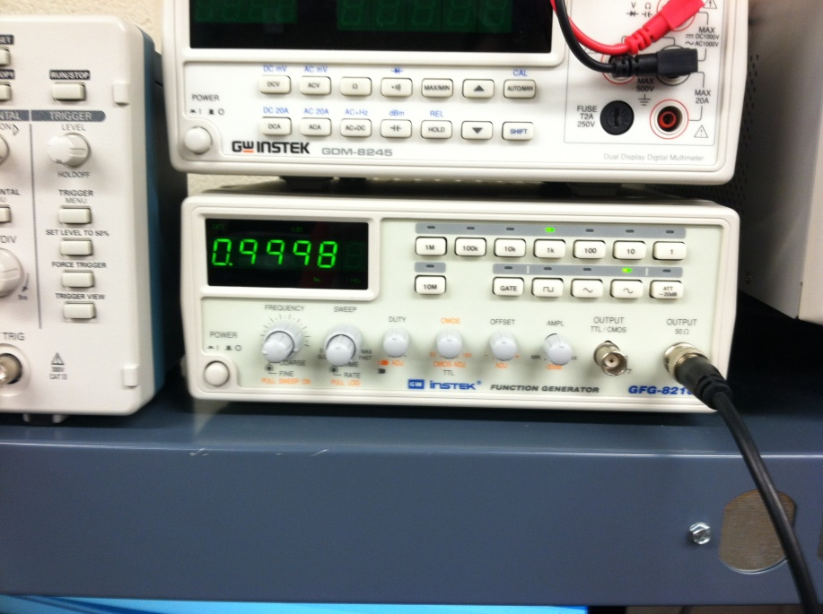
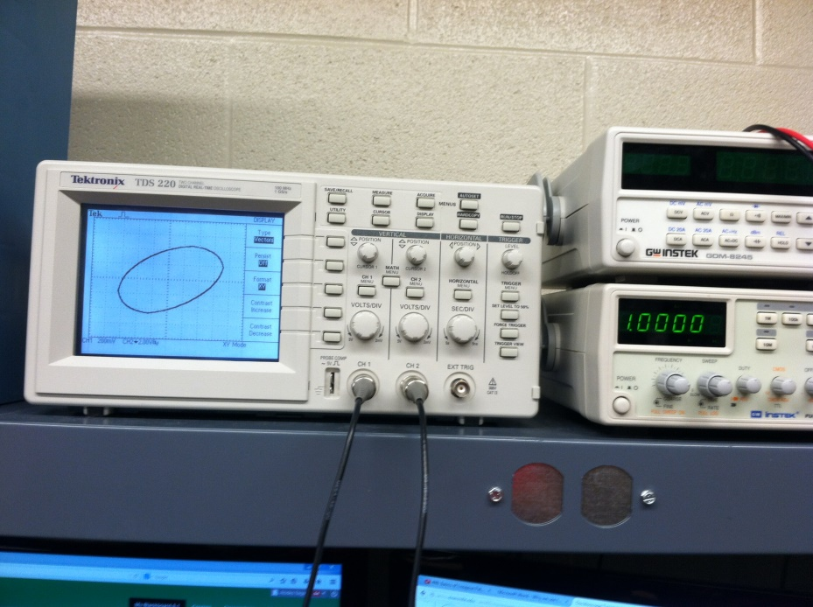
Lab 12 – Lissajous Pattern

Slide 55
Lab 13 – AC to DC
Power Supplies
Objective
Convert AC to DC
Equipment and Material
Oscilloscope
Function Generators
Solderless Breadboard
4- Diodes (1N4148)
1- Capacitor (100µF)
Research and Information
Watched video: “AC to DC Converter: Bon Jespersen”

Slide 56
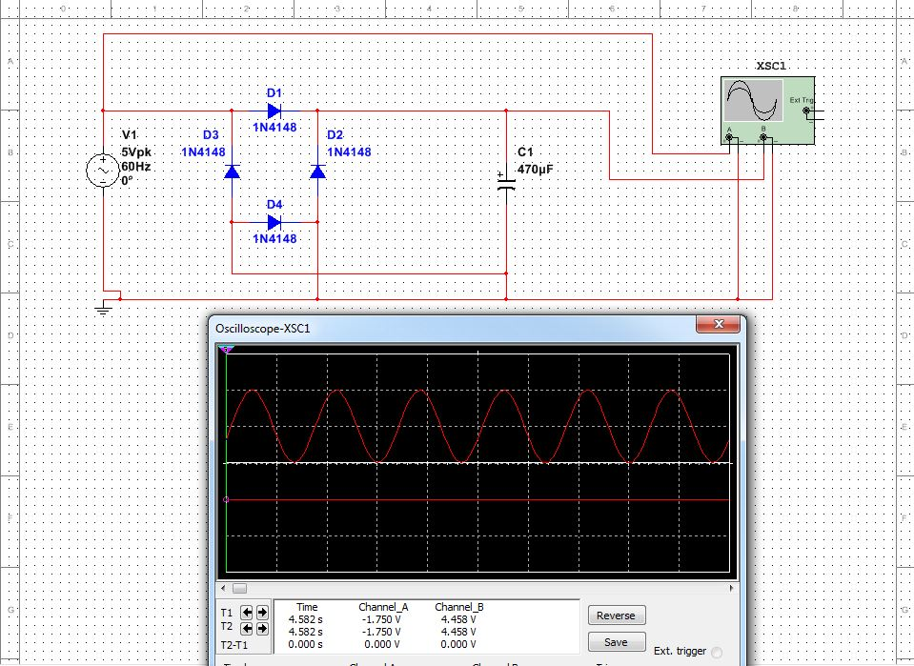
Lab 13 – AC to DC
Power Supplies
Make an schematic on Multisim

Slide 57
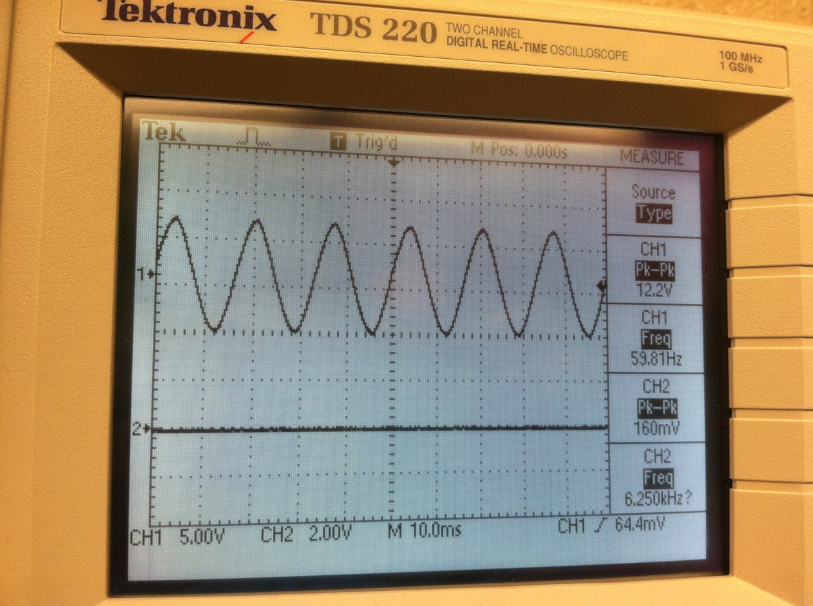
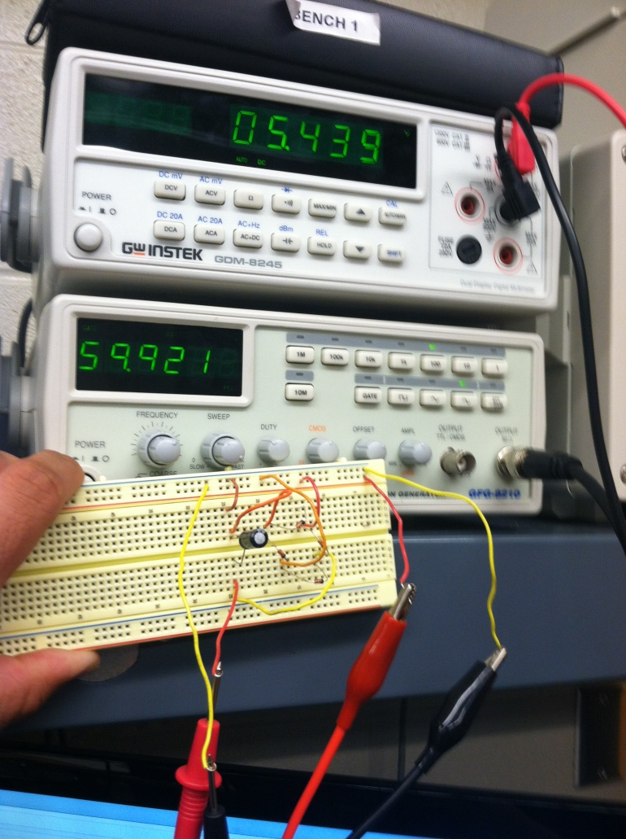
Lab 13 – AC to DC
Power Supplies
Built a converter on a breadboard

Slide 58
Lab 14 – ESD
Objective
Know what ESD is and how it can affect electronic devices
Know how to prevent or minimize ESD
Find the approximate voltage generated by:
Masking Tape
Scotch Tape
Wool Sweater
Walking across the carpet in the winter
Research and Information
Definition of ESD on: http://whatis.techtarget.com/definition/electrostatic-discharge-ESD
Found how to prevent ESD on website: http://www.minicircuits.com/app/AN40-005.pdf

Slide 59
Lab 14 – ESD
ESD (Electro Static Discharge)
Is the release of static electricity when 2 things come in contact with each other.
Some examples are:
Dragging your feet across a carpet and touching a metal object or a person.
Static electricity from dried clothes in dryer.
Lightening bolt
ESD Info
While most of the ESD are harmless to the human body. It is very damaging to electronic devices.
Two kids of damages can occur:
Catastrophic Damage: The device stops working immediately.
Latent Damage: Device appears to continue working, but could stop in the future.

Slide 60
Lab 14 – ESD
ESD Prevention
In the work Area one can use Anti Static:
Table mat
Floor mat
Tweezers
Carrier tape
Bag
Personnel can
Discharge themselves by wearing a ground antistatic wrist-strap
Use antistatic:
Smock
Finger cots

Slide 61
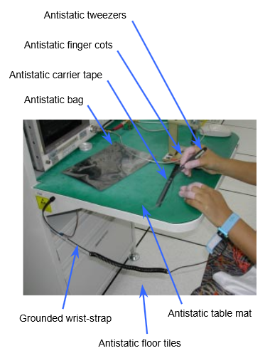
Lab 14 – ESD

Slide 62
Lab 15 – Test Old
0-30VDC
Objective
Test voltage with multimeter:
5V
10V
20V
30V
Equipment
DMM
0-30 VDC
Research and Information
Review how to test voltage from previous labs

Slide 63
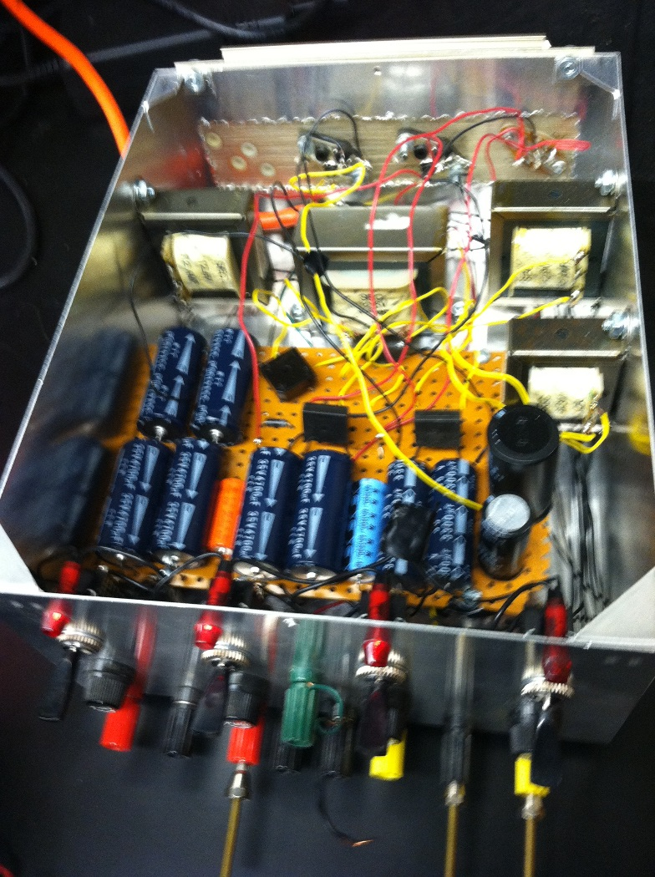
Lab 15 – Test Old
0-30VDC

Slide 64
Lab 16 – Final Project
Objective
Solder together a Flashing European Siren (AK-100)
Equipment and Material
DMM
Function Generator
Soldering Iron.
Wet Sponge
Angle Cutter
AmeriKit (AK-100) with schematic
9 Resistors: 1 @ 68Ω, 2 @ 470Ω, 1 @ 1kΩ, 2 @ 10kΩ, 2 @ 22kΩ, 1 @ 47kΩ, 1 VR @ 200Ω Trim Pot
Capacitors: 2 @ .02µF, 3 @ 10µF, 1 @ 100µF
Semiconductors: 2 – 2N3904, 1 – IC 555, 2 LED (red)
Breadboard
Speaker
Wire 22AWG solid 3’
Research and Information
Read instruction in the kit

Slide 65
Lab 16 – Final Project
Test all components
Solder components in this order
Resistors
Capacitors
Semiconductors
Speaker
Battery snap
Check soldering
Connect battery to see if it works

Slide 66
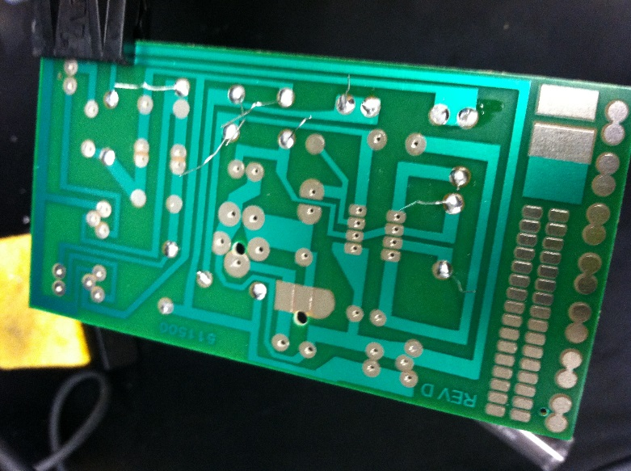
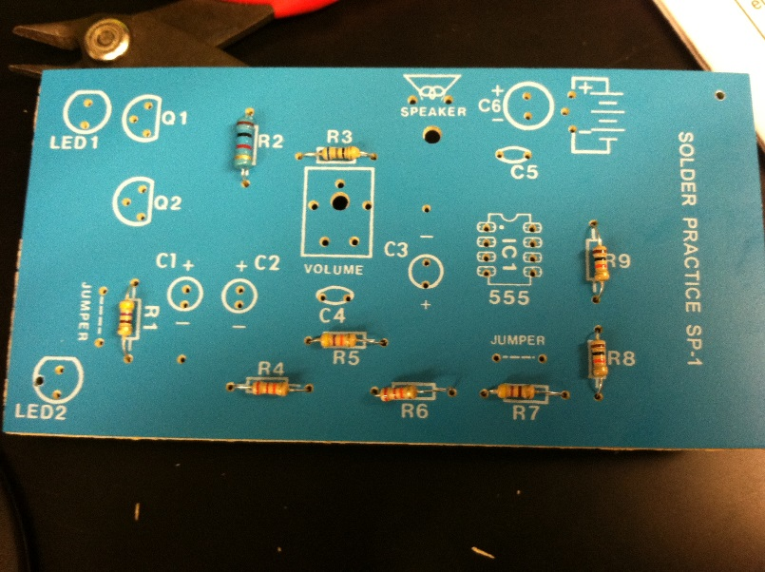
Lab 16 – Final Project
Soldering

Slide 67
Lab 16 – Final Project
It works!!!

